Slide 1
Proposal:
The Pygmy Dipole Resonance in ⁶⁴Fe
and the properties of neutron skin
Collaboration:
O. Wieland, A. Bracco, F. Camera, G. Benzoni, N. Blasi, S. Brambilla, F.C.L. Crespi, S. Leoni, B. Million, et al., Dip. di Fisica and INFN, Sezione di Milano, Italy
A. Maj, M. Kmiecik, P. Bednarczyk, et al., The Niewodniczanski Institute of Nuclear Physics, PAN, Krakow, Poland
G. de Angelis, D.R. Napoli, et al., INFN, Laboratori Nazionali di Legnaro, Italy
D. Bazzacco, E. Farnea, S.M. Lenzi, S. Lunardi, et al., Dip. di Fisica and INFN, Sezione di Padova, Italy
J. Gerl, M. Gorska, H.J. Wollersheim, T. Aumann et al., GSI, Darmstadt, Germany
et al. …
and the AGATA-PRESPEC and FRS collaboration.
After last G-PAC evaluation:
Notes:
The G PAC gave some advices which we respected:
Explicit Statistical model gamma branch calculations. Done very accurate.
At the moment the PAC considered more attractive more heavier nuclei near to shell closures. WE went to 64Fe, BUT
We want defenetifely ALSO measure 26Ne.
But give priority now in, also and particularly with respect to recent outcomings of the analysis in 68Ni, to 64Fe.
PAC: no E1 strenght under threshold (but QRPA shows poorely this levels , for example 2+ etc states are also very interesting)
PAC: experiment cannot disentangel collective or single particle states, ovvious ! BUT with thelp of theory and Coulomb breakup….

Slide 2
Outline
Motivation
Technique
Last RISING results on Pygmy in ⁶⁸Ni and neutron skin
Strenght distribution in ⁶⁴Fe
Conclusions PROPOSAL and FUTURE

Slide 3
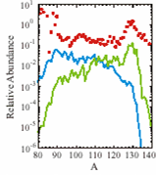
Pygmy Resonance
Collective oscillation of neutron skin against the core
-Level of collectivity ?
-How collective properties change with N ?
- Different theoretical approaches give different predictions in terms of collectivity, strength and line-shape of the pygmy resonance
E1 strength shifted towards low energy
10¹
10⁰
10⁻¹
10⁻²
10⁻³
10⁻⁴
10⁻⁵
10⁻⁶
exp
Nupecc long range plan 2004
Relative Abundance
“Giant resonances are of paramount importantce for nuclear astrophysics. …
For instance, neutron-rich nuclei with loosely bound valence neutrons may exhibit very strong (γ,n) strength components near particle threshold and thus, in turn, enhanced neutron-capture rates.”
Theory
+pygmy
80 90 100 110 120 130 140
A
S.Goriely, Phys. Lett. B436 10 (1998)
S.Goriely and E. Khan, Nucl. Phys. A706 (2002) 217

Slide 4
From the pygmy dipole resonance
One can derive:
Nuclear symmetry energy
Neutron skin
Data on neutron rms radius constrain the isospin-asymmetric part of the Equation of state of nuclear matter
Note that:
Relation between neutron skin and neutron stars :
both are built on neutron rich nuclear matter so that one-to-one correlations can be drawn
Impact on r-process

Slide 5
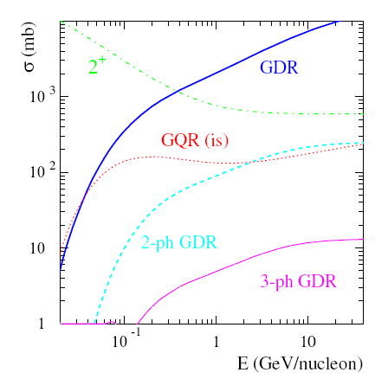
Virtual photon scattering technique
High selectivity for dipole excitation !!
Virtual Photon
spectra E1
Virtual photon excitation
and decay of GDR - PYGMY
200
150
100
50
γ
E_{max}
0
1
10
100
E* (keV)
Coulex
GDR Ground state decay
branching ratio ~ 2% measured on ²⁰⁸Pb
T.Aumann et al EPJ 26(2005)441
To excite Dipole states one need:
High beam energy
  Large cross sections
  Large σ_{GDR}/σ_{GQR} ratio
To Select projectile PDR one needs:
High beam energy
  Large Doppler effects
  Good Z_{proj}/Z_{target} ratio
Reaction Cinematics
Nuclear Structure

Slide 6
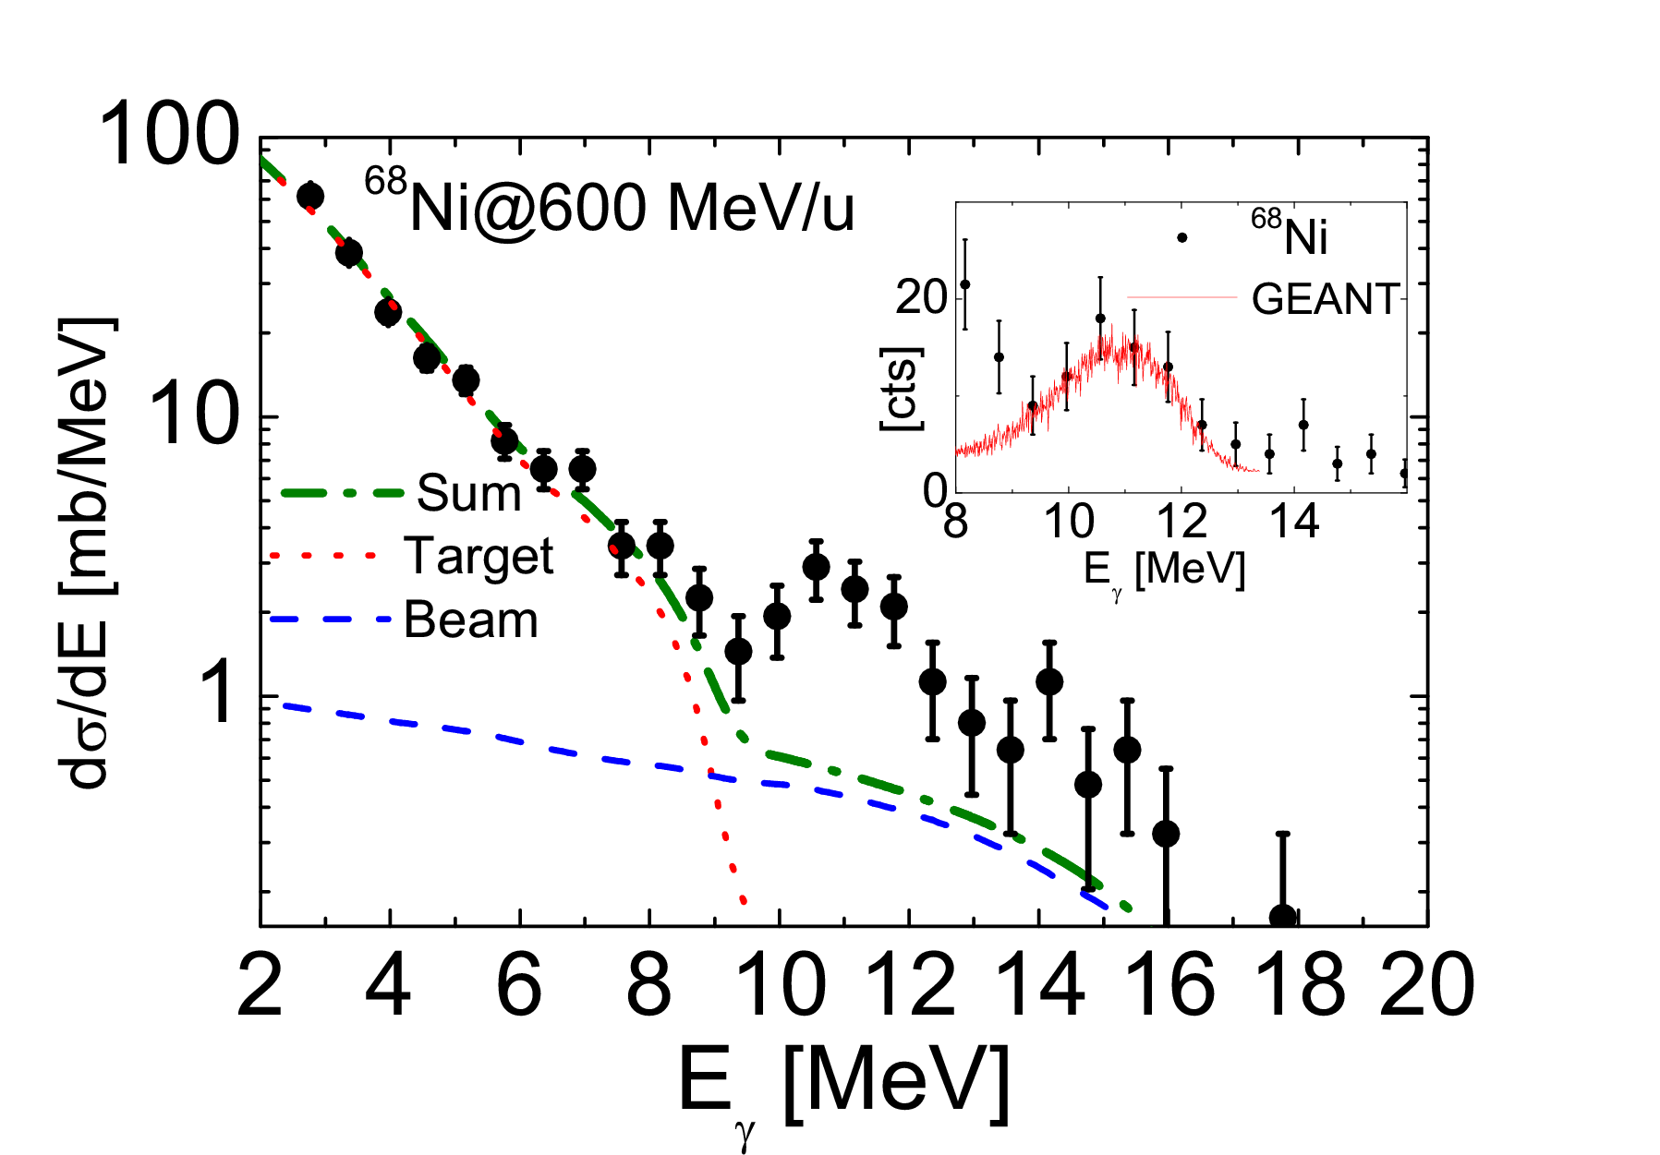
⁶⁸Ni ANALYSIS:
RISING EXPERIMENT
April 2005
⁶⁸Ni at 600 MeV/u
4 10³ events/sec (sc41)
7 days of beam Time
Conditions:
⁶⁸ Ni-incoming-selection
⁶⁸ Ni-outgoing-selection
TOF-in prompt
Outgoing angle check
Doppler correction
mγ=1
Detector specific
  PSA, AddBack
Statistical model (Cascade) calculation of γ-rays following statistical equilibration of excited target nuclei (¹⁹⁷Au) and of the excited beam nuclei (⁶⁸Ni) folded with RF and in the CM system
Excess Yield
Notes:
Gammas da Au emesso dal Target (fermo) con E* 18.5 (per farlo coretto uno dovrebbe fare tra 0 e 20 MeVseguendo i virtual fotons, questo e tenuto conto !! e risulta in uno slope come si vede !!!! ) nella simulazione widht and position preso da fotoabsorption !
Stat model per tutti decay CHN.
Poi viene spostato verso energie piu alte = Doppler correction secondo experimental condition con resposta a zero beta.
Oro viene coulomb.excitet nel target 8-10 volte piu basso rispetto al nickel nel CM.
Attenzione ce anche la risposta del CFD in mezzo !
Gammas da nickel solo primo step emessi in volo poi doppler correcte verso alte energie. Response function con lorentz boost.

Slide 7

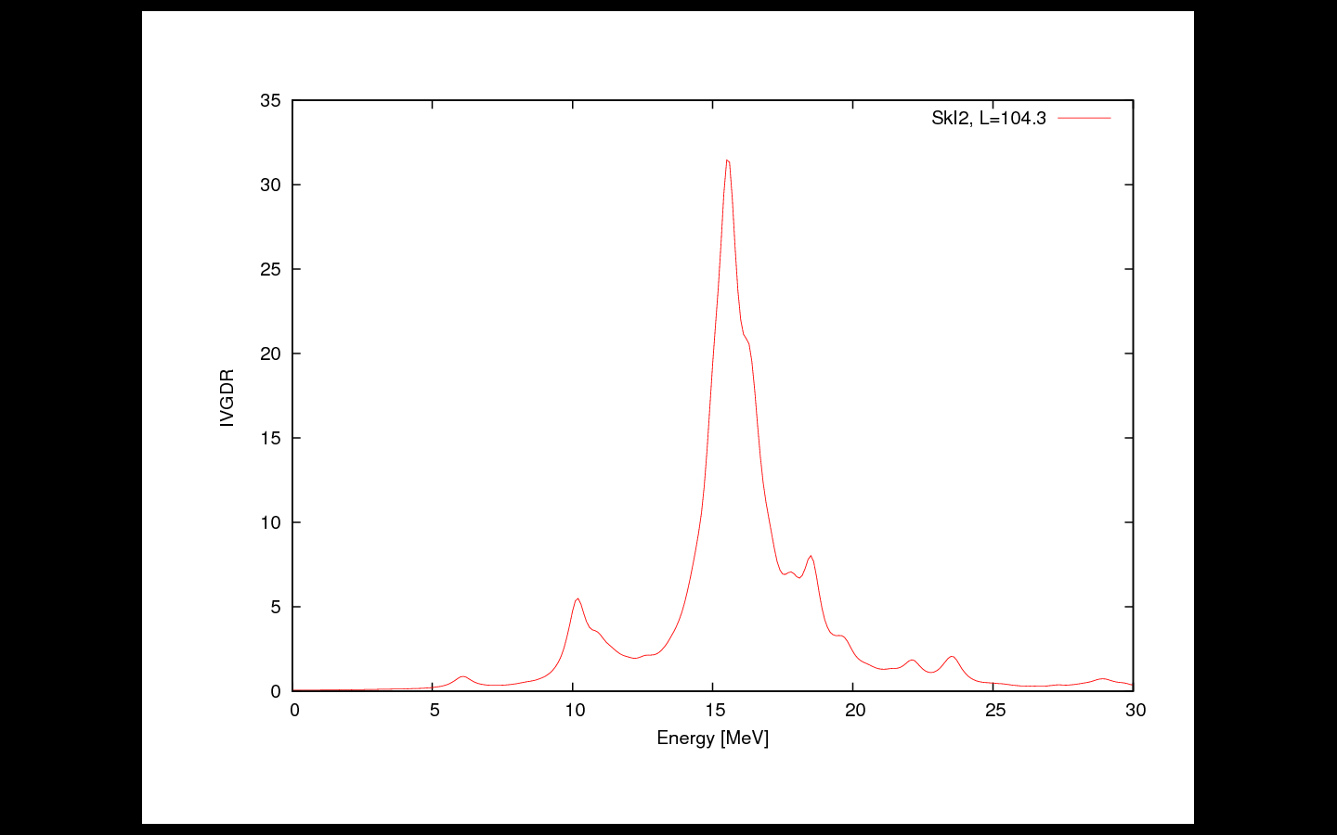
Relativistic Coulomb excitation probability
is directly proportional
[Eisenberg,Greiner, Bertulani, Baur, Alder,Winther, Weizsaecker, Williams…]
to the Photonuclear cross section
virtual photons
Photonuclear
cross section
GDR
ResponseFunction
Folded with the
detector response
function
PDR
γbranching
Excess Yield is
interpreted as PDR
Theory
RPA
PDR
5% +/-1
⁶⁸Ni
GDR
~10-11 MeV
G. Colo
without pygmy
O.Wieland et al. PRL 102, 092502 (2009)
Notes:
From “photonuclear data” + Thomas reiche kuhn EWSR.

Slide 8
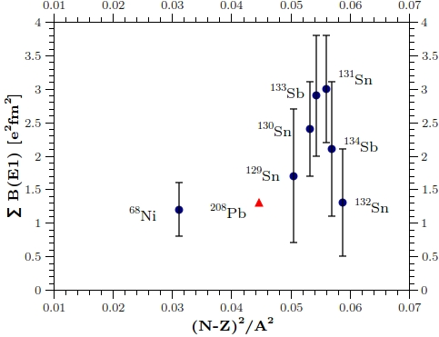
Compare the strength in ⁶⁸Ni with Sn data
Lower value of the B(E1) in ⁶⁸Ni as compare to the Sn region
This is consistent with the fact that (N-Z)²/A² is smaller
(N-Z)²/A² governs the symmetry energy in finite nuclei
⁶⁸Ni
This is the first hint that from the strength of the pygmy
one could get information on the symmetry energy
Notes:
COMPARE RESULTS 1

Slide 9
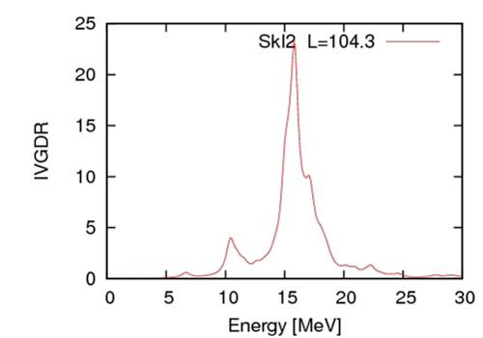
Compare strength of pygmy in ⁶⁸Ni with theory
SkI2
Note that the shape and strengh depends on the effective force
Calculations of different types are available:
Microscopic Hartree-Fock + random phase approximation
Relativistic Quasi particle Random Phase approximation
Notes:
COMPARE RESULTS 2

Slide 10
→ Associated EOS quantities
Symmetric matter EOS
Symmetry energy S
Nuclear matter EOS
The density dependence of the symmetry energy is poorly constrained and one would like to know the key parameters
Define:
Slope parameter L
(derivative of symmetry energie)
On the other Hand:
It is well understood, that the formation of the neutron skin is governed by density dependence of nuclear Symmetry energy [Brown Frunstahl Sagawa]
Notes:
FURTHER ANALYSIS
It is well understood, that the formation of the neutron skin is governed by density dependence of nuclear
Symmetry energy [Brown Frunstahl Sagawa]

Slide 11

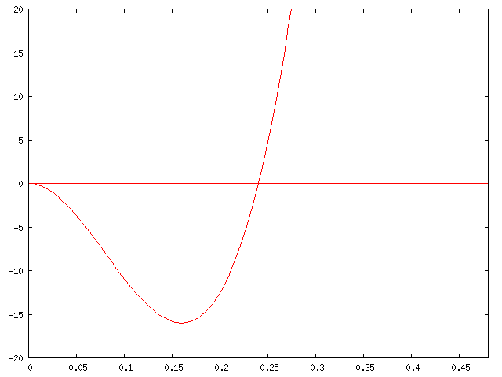

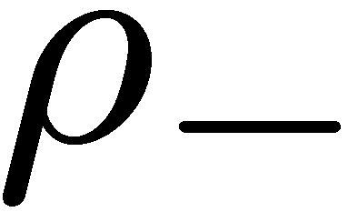
The largest uncertainities concern the ISOVECTOR, or SYMMETRY part of the energy functional which is very POORLY constrained.
It has been shown that the GDR can constrain the symmetry energy at density around 0.1 fm⁻³ while the PDR can constrain the derivative of the symmetry energy.
usual (stable) nuclei
neutron-rich (unstable) nuclei
L. Trippa et al., PRC 77, 061304(R), A. Carbone et al., PRC in press

Slide 12
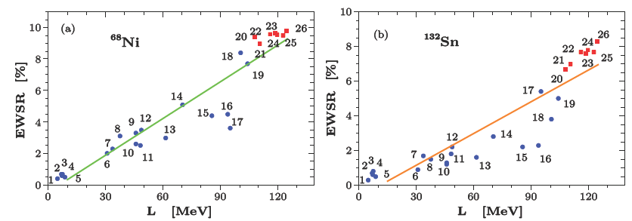
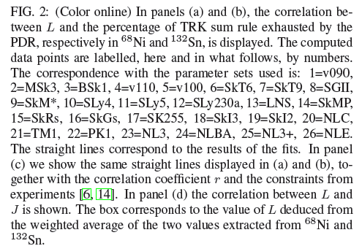
Correlation between L and the PDR
Correlation between L and the PDR strenght calculated for
Different nuclei and different classes of EDFs(Energy Density Functionals).
Blue=Skyrme; red=RMF.
Notes:
Correlation between L and the PDR has been worked out (found by) FURNSTAHL, BROWN
And applied to PDR by KLIMKIEWICZ et al
At present there is an enormous effort aiming determining the parameters that govern the asymmetric EOS,
Using experimental and theoretical tools.
Energy Density Functionals

Slide 13
Constraint on J and L
Exp. values from O. Wieland et al., PRL 102, 092502 (2009); A. Klimkiewicz et al., PRC 76, 051603(R) (2007).
We deduce the weighted average for L → then, J under that constraint
A. Carbone et al., Phys. Rev. C 81, 041301(R) (2010)
30< J <34 from Sn analysis of ref PRC76(2007)051601
Notes:
We found rather good correlation between the parameter L and the percentage of EWSR associated with the PDR
Practically the neutron skin thickness for a given nucleus is practically linearly correlated to J and rho_0

Slide 14
Extract the neutron radius for ²⁰⁸Pb
Use the L value from the
analysis of the exp
of ⁶⁸Ni and ¹³²Sn
ΔR
L(MeV)
A. Carbone et.al., Phys. Rev. C 81, 041301(R) (2010)
and using the value of L deduced
from ⁶⁸Ni and ¹³²Sn for ²⁰⁸Pb one obtains
R_{n}-R_{p} = 0.195+/- 0.021 for ²⁰⁸Pb
Notes:
One can connect the n-skin radius (r_neutron - r_proton) .
Relation strenght to neutron skin radius (Piekarewicz)
Neutron skin radii versus symmetry energy Furnstahl relation

Slide 15
Comparison with other ways of constraining L
Our general approach of extracting L (derivative of symmetry energie) from the PDR makes its value compatible with those from analysis of heavy-ion collisions.
Contraints on the
symmetry energy in agreement with heavy ion fragmentation and with Anti-proton
  BUT:
  MORE DATA ARE NEEDED
[THIS WORK] A. Carbone et al., Phys. Rev. C 81, 041301(R) (2010)
[9] M. B. Tsang et al., Phys. Rev. Lett. 102, 122701 (2009).
[10] D. V. Shetty et al., Phys. Rev. C76, 024606 (2007).
[8] L. W. Chen et al., Phys. Rev. Lett. 94, 032701 (2005).
[26] P. Danielewicz, Nucl. Phys. A727, 233 (2003).
[25] P. Danielewicz and J. Lee, Nucl. Phys. A818, 36 (2009).
[11] M. Centelles et al., Phys. Rev. Lett. 102, 122502 (2009);M. Warda et al., Phys. Rev. C80, 024316 (2009).
[6] A. Klimkiewicz et al., Phys. Rev. C76, 051603(R) (2007).
Notes:
[THIS WORK] A. Et al., Phys. Rev. C 81, 041301(R) (2010)
[9] M. B. Tsang et al., Phys. Rev. Lett. 102, 122701 (2009).
[10] D. V. Shetty et al., Phys. Rev. C76, 024606 (2007).
[8] L. W. Chen et al., Phys. Rev. Lett. 94, 032701 (2005).
[26] P. Danielewicz, Nucl. Phys. A727, 233 (2003).
[25] P. Danielewicz and J. Lee, Nucl. Phys. A818, 36 (2009).
[11] M. Centelles et al., Phys. Rev. Lett. 102, 122502 (2009);
M. Warda et al., Phys. Rev. C80, 024316 (2009).
[6] A. Klimkiewicz et al., Phys. Rev. C76, 051603(R) (2007).

Slide 16
→PROPOSAL
The Pygmy Dipole Resonance in ⁶⁴Fe
and the properties of neutron skin

Slide 17
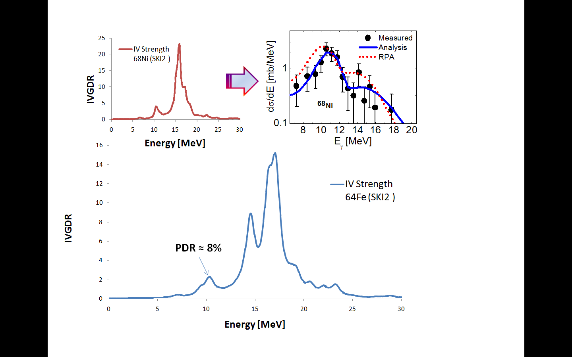
The Pygmy Dipole Resonance in ⁶⁴Fe
and the properties of neutron skin
RPA(Skl2) calculations for ⁶⁴Fe.
New Measurement of PDR strenght
Will give usefull information
On relation EWSR-vs-L
To disentangle the PDR+GDR finestructure DOPPLER correction with AGATA is needed
? ?
⁶⁴Fe
ΔR
Notes:
2+ 746
4+ 1763

Slide 18
FUTURE :
We plan measurements in ²⁶Ne,
¹⁰⁰Zr and ⁸²Ge
Fragmentation of the strength in ²⁶Ne
Search for pygmy in deformed ¹⁰⁰Zr
Search for strength around threshold in ⁸²Ge
Notes:
Strenght distribution in ⁶⁴Fe, ²⁶Ne, ¹⁰⁰Zr and ⁸²Ge

Slide 19
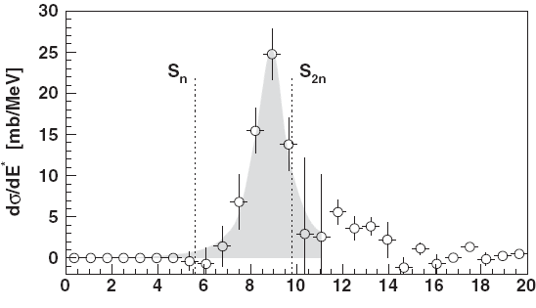
Fragmentation of the strength in ²⁶Ne
Virtual Photon Breakup Method @ 85AMeV
“Systematic” E1 Strength predicted by QRRPA calculations
(for deformed Ne nuclei)
1.2
S [e²fm²/MeV]
²⁸Ne
?
0
²⁶Ne
0
Figure 1: Reconstructed excitation energy spectra from the Coulomb break up measurement [10] of the dipole strength distributions for ²⁶Ne in function of the gamma ray energy after substraction of background and E2 contributions.
J. Gibelin et al., Phys. Rev. Lett. 101, 212503 (2008).
²⁴Ne
0
²²Ne
0
²⁰Ne
0
B(E1) = 0.60±0.06 e²fm²
or 5.9 ± 1.0% of TRK sum rule @ 9 MeV
E* [MeV]
Cao L.-G. and Ma Z.-Y. Phys. Rev. C 71, 034305 (2005)
Notes:
The previous proposal on ²⁶Ne was intended to focus on the fragmentation of the strength in light nuclei and to confirm, with another technique the results obtained at RIKEN based on a measurement at lower bombarding energy (at 58 MeV/nucleon) where contributions of other multipolarities were identified. Instead, if one wants to concentrate on the neutron skin analysis, very recently completed for ⁶⁸Ni, the case of ⁶⁴Fe is the best, within the nuclei accessible with our set up and beam intensities

Slide 20
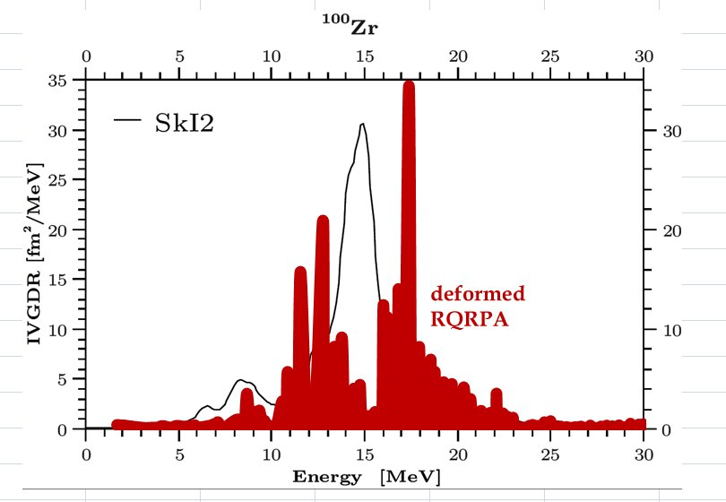
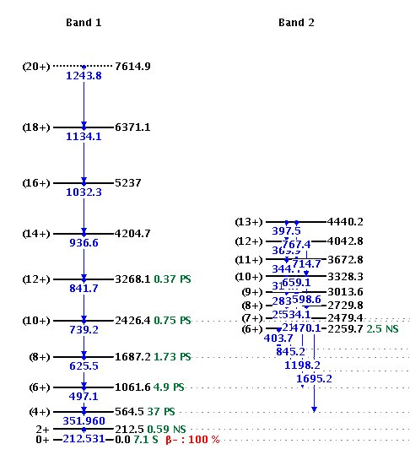
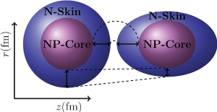
Search for pygmy in deformed ¹⁰⁰Zr
To disentangle the PDR finestructure DOPPLER correction with AGATA is needed
RQRPA highly deformed with beta=0.4
calculations done by
Daniel Pena Arteaga ipno.in2p3.fr Orsay
OPEN QUESTION: Deformation hinders the dipole strength
BUT low-lying E1 strength increases with the neutron number
D. Pena Arteaga, E. Khan, and P. Ring PHYSICAL REVIEW C 79, 034311 (2009)
Notes:
PROLATE

Slide 21
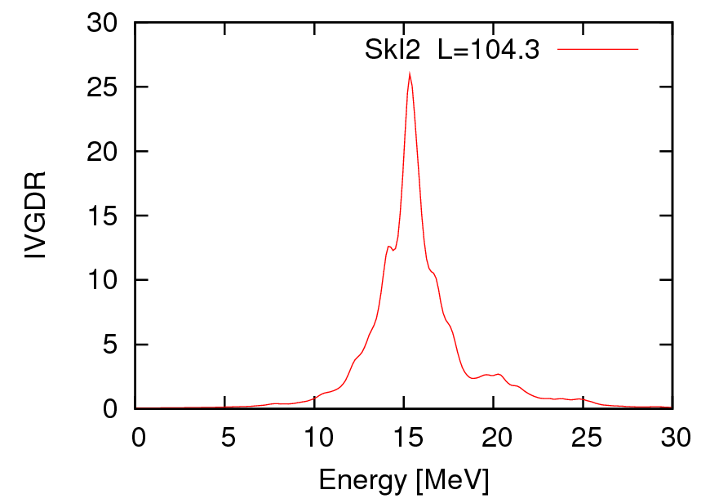
Search for strength around threshold in ⁸²Ge
N/Z (N-Z)²/A
⁶⁸Ni: 1.43 0.031
⁶⁴Fe: 1.46 0.035
¹⁰⁰Zr: 1.5 0.04
⁸²Ge: 1.56 0.048
²⁶Ne: 1.6 0.053
¹³²Sn:1.64 0.059
?
PREDICTION:
RPA(Skl2) calculations for ⁸²Ge.

Slide 22
MEASUREMENTS OF THE γ DECAY OF THE PYGMY DIPOLE RESONANCE in ⁶⁴Fe
GSI is unique place where we have combination of Beam intensity, species, energy AND Tracking-Detector-systems to do this relativistic coulomb excitation.
For PDR finestructure DOPPLER correction with AGATA is needed.
The plan is to study first the nucleus ⁶⁴Fe to infer
the size of neutron skin by improving the technique used for ⁶⁸Ni.
BEAM TIME REQUESTS
Based on our assumptions of beam intensities and experience
with ⁶⁸Ni we would request 7 days (21 shifts) for the data taking
7 days with Beam on the Pb target
Notes:
of astrophysical interest ⁶⁴Fe

Slide 23
FUTURE: ²⁶Ne, ¹⁰⁰Zr and ⁸²Ge
For PDR finestructure DOPPLER correction with AGATA is needed.
The experiment on ²⁶Ne will give important, complementary Information to the Coulomb Breakup experiments
The experiment on the deformed nucleus of ¹⁰⁰Zr is very important and will give completely inside in the interpretation of the PDR.
The experiment on the neutron rich nucleus ⁸²Ge will be a good test for theory, which predicts the absence of strenght around the threshold
7 days with Beam on the Pb target for EACH of THE ISOTOPES

Slide 25
The Pygmy Dipole Resonance in ⁶⁴Fe
and the properties of neutron skin
MEASURED at 400AMeV

Slide 26
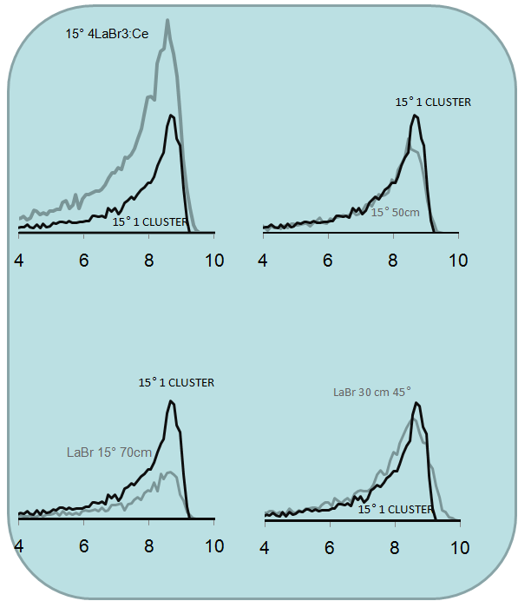
With Lorenz boost
at 60% v/c

Slide 27
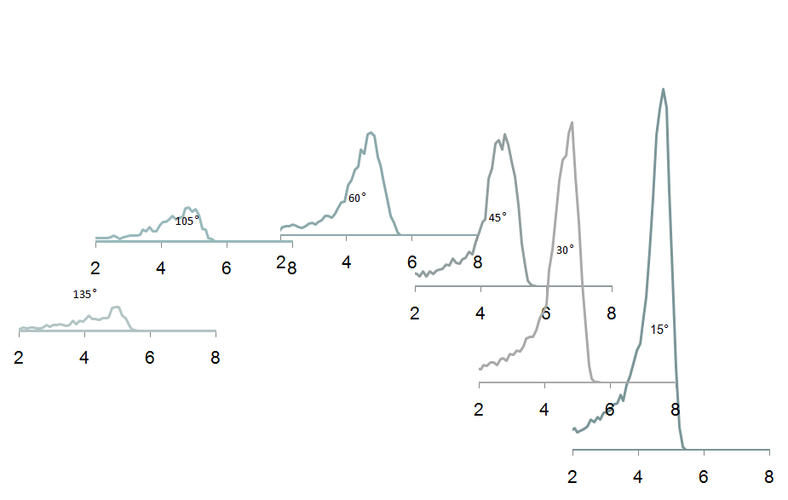
LaBr3:Ce
LaBr3:Ce Detectors at
different angles (50cm)
around the Target
γ
γ

Slide 28
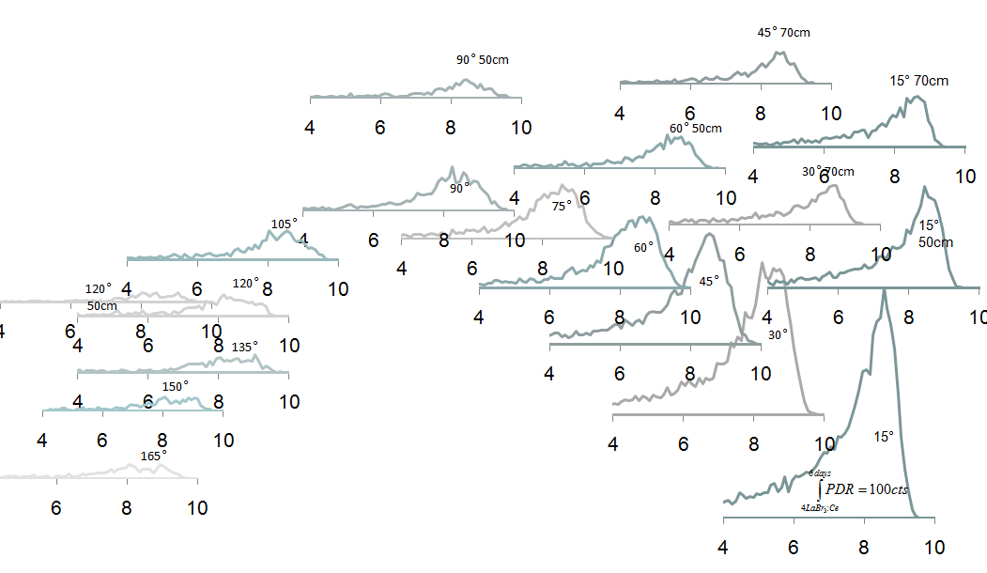
LaBr3:Ce
LaBr3:Ce Detectors at
different angles and distances
around the Target
γ
γ
Beam

Slide 29
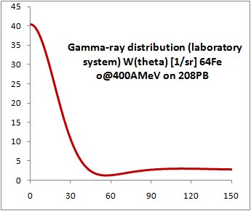

Slide 31
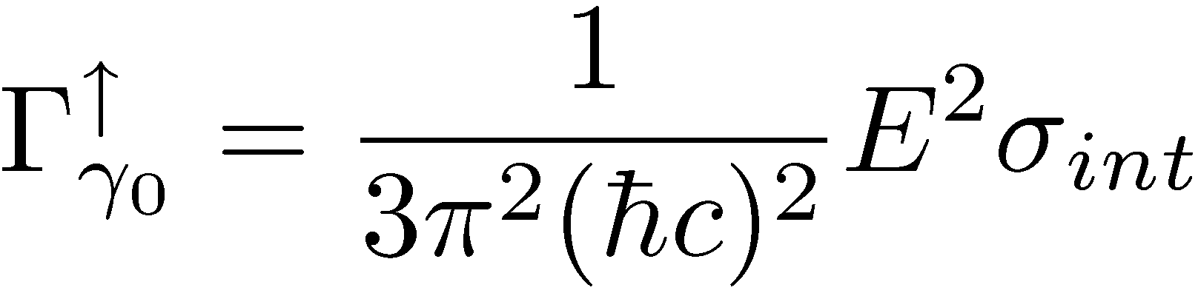
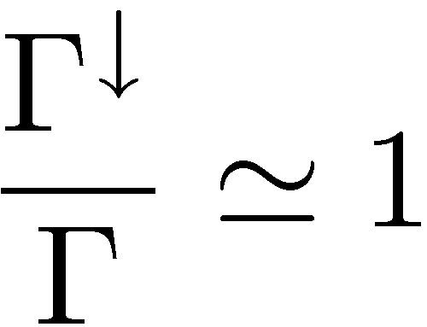
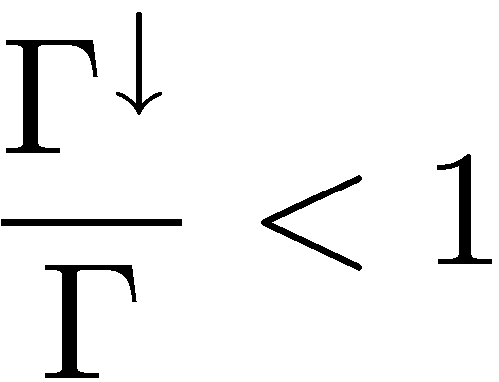
(GDR-PDR) Coulomb excitation of ²⁶Ne or ⁶⁸Ni at relativistic energies
The extraction of the B(E1) strength requires the estimation of the direct and compound γ-decay of the dipole state to the ground state
The compound term depends on the
ratio between the gamma and total
decay width
J.Beene et al PRC 41(1990)920
The gamma decay width depends on
The value of the level density at the resonance energy
J.Beene et al PLB 164(1985)19
S.I.Al-Quiraishi PRC 63(2001)065803
Direct
Spreading width
σ_{int} = photo-absorption cross-section
Heavier nuclei
Lighter nuclei

Slide 32
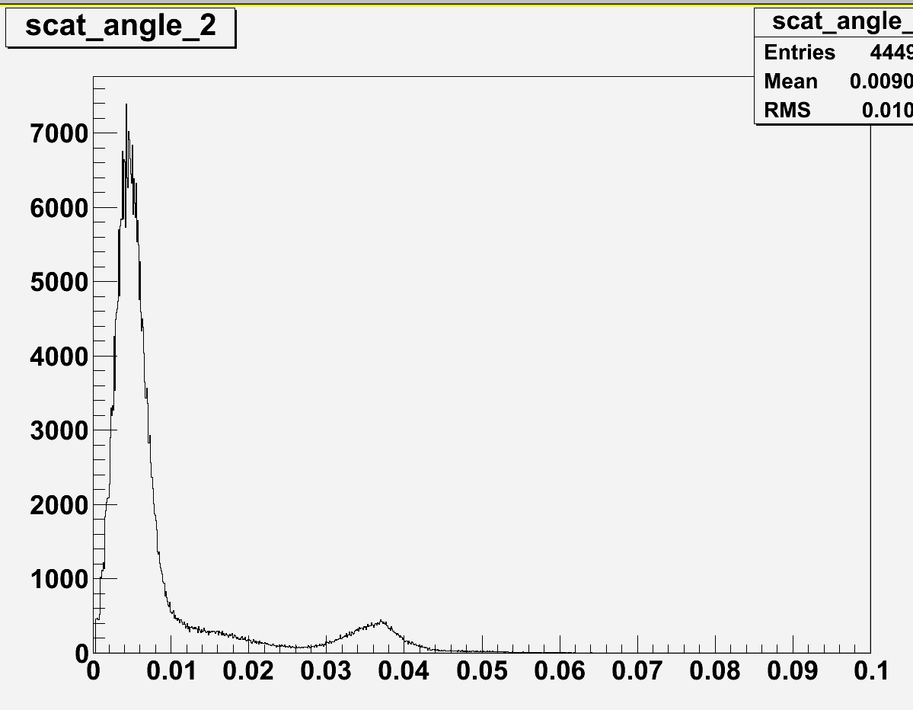
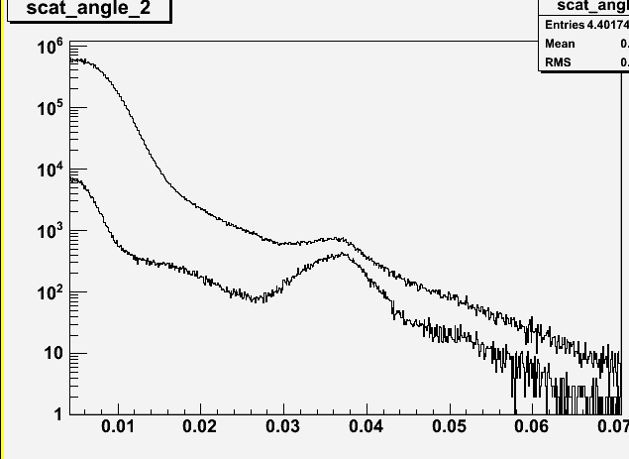
Au target
Be target

Slide 33
Coulomb excitation of the 2⁺ state in ⁶⁸Ni
at 600 MeV/u
Consistency check for
Doppler correction
mass identification
cross section
E2 in ⁶⁸Ni
2034 keV - 2⁺
Comparison RISING with GANIL exp.
excitation of the 2⁺ in ⁶⁸Ni
2⁺ 2743 keV ?
17.8mBarn
RISING
GANIL -ex
Sorlin et al
Sorlin et al. Phys. Rev. Lett (2

Slide 34
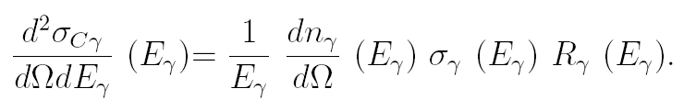
ground state gamma-ray decay from a GR state
following a Coulomb excitation
The measured γ-ray yield is due to the product
of 3 terms:
Virtual photon N, photoabsorption cross sect, Branching
[… Beene, Bortignon,
Bertulani …]
! Coulomb excitation probability
is directly proportional to the Photonuclear cross section
[Eisenberg,Greiner, Bertulani,Alder,Winther,…]
Integration over
Ω or b
N(E_{γ},E1)= 2π∫b(n(E_{γ},E1))db
Notes:
We calculated now the giant gesonance following coulomb excitation:
The Coulomb excitation can be treated as a photoabsorption induced by a virtual photon [bert. Baur…]
The coulomb excitation cross section and corresponding photoabsorption cross section are related with the equivalent photon number n.
The Coulomb excitation is factorized in two parts: the photoabsorptio cross section depending on the structure of the nucleus and the equivalent photon number n, responsible for the coulex. Machanism.
The essential theory for the excitation is that of Weiz. Williams method ,as aplied by Llo90 (see formula above) with the giant resonance strenght function as input.
QUINDI
We used the fact, that the coulex is directly proportional to the photonuclear cross section

Slide 35
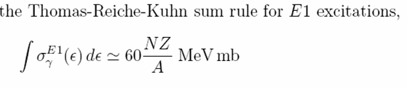
Photo
absorption
cross
section
⁶⁸Ni
⁶⁰Ni
PDR
+ GDR

Slide 36
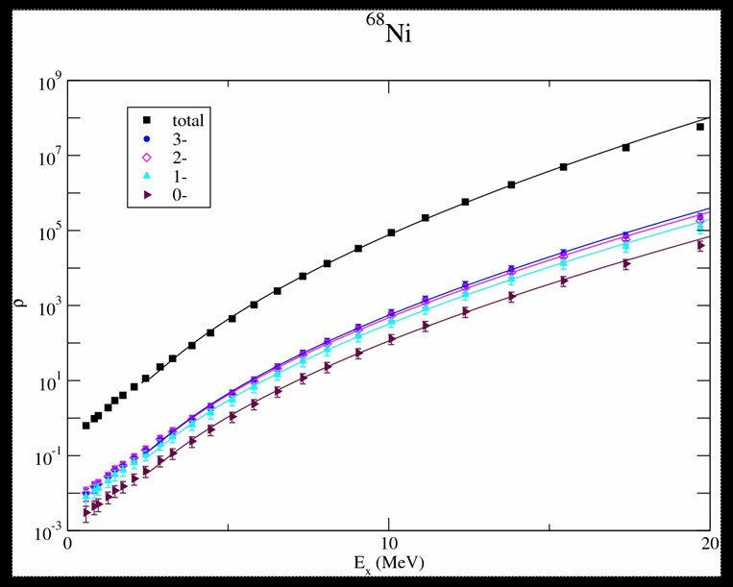

Gamma decay –
Branching ratio and level density
level density
Branching Ratio for γ
Two-steps model,
direct GR decay + the compound states :
R_{γ}(Ε_{γ}, ρ_{LD})
< >
< >
[Beene, et al PLB (1985)]
C.N. Gilbreth and Y. Alhassid, private communication
Shell model Monte Carlo (SMMC)
Y. Alhassid et al. PRL 99, 162504 (2007
Direct_gamma_dacay_width (ground state photon decay width) <gamma width>
________________________ + compund term
Spreading width of the resonanze (experimental width of the state) <total width> SUM_over_individual states
Notes:
No measurements available for LD for this nucleus and for this excitation energy !
Direct_gamma_dacay_width (ground state photon decay width) damping width * <gamma width>
________________________ + compund term
Spreading width of the resonanze (experimental width of the state) <total width> SUM_over_individual states

Slide 37
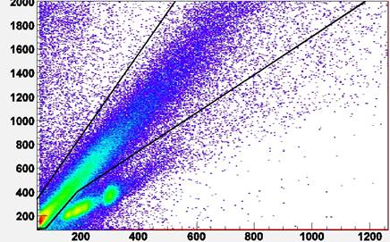

Technical Details
Importance of a good timing
BaF₂
HPGe MiniBall
HPGe
CLUSTER
2
FRS
3
1
CATE
LYCAA
Beam
Start Detector
Target
No Gate
The good timing properties
allows to distinguish events
originating
from interactions occuring
outside the target
Counts HPGe (lin)
Counts BaF₂ (log)
1
3
2
190
200
210
220
230
t (ns)

